Slide 1



Technical Presentation
Introduction to Cryptography and Information Security
CSA5112 – Cryptography and Network Security
By:
CH Aravind (192325093)

Slide 2



Cryptography and Information Security
Information Security (InfoSec) protects data from unauthorized access, modification, disclosure, or destruction.
It ensures data remains confidential, accurate, and available.
It is essential for protecting personal, business, and government information.
Why is it Important?
Protects sensitive personal and financial information.
Prevents cyber attacks and data breaches.
Builds trust in digital communication and online services.
Real-World Examples: 🏦 Online Banking
💬 WhatsApp Messaging
☁ Cloud Storage

Slide 3

Security Goals (CIA Triad)
Confidentiality
Ensures only authorized users can access information.
Protects sensitive data from unauthorized disclosure.
Example: Password-protected online banking.
Integrity
Ensures data remains accurate and unaltered.
Prevents unauthorized modifications.
Example: Exam results stored securely.
Availability
Ensures systems and data are accessible whenever needed.
Prevents downtime and service interruptions.
Example: ATM services available 24/7.
Bell–LaPadula Security Model
A security model focused on maintaining confidentiality.
Used in military and government systems.

Slide 4
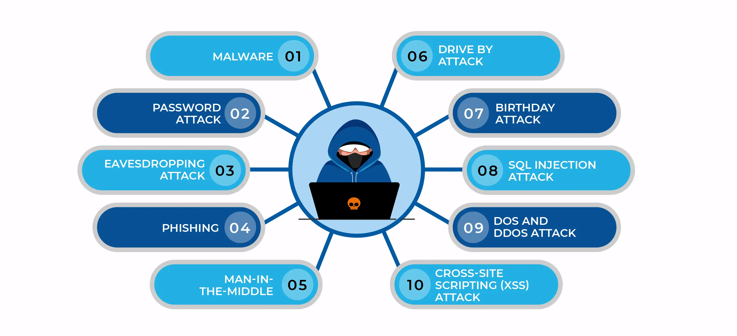
Security Attacks, Threats, and Risks
Security Attack
An attempt to gain unauthorized access or damage a system.
Can compromise data confidentiality, integrity, or availability.
Common Attacks Malware Phishing, Password Attacks , Denial-of-Service (DoS) , Man-in-the-Middle (MITM)
Threat A potential source of harm that can exploit vulnerabilities.
Examples
Hackers , Computer Viruses , Insider Threats , Natural Disasters
Risk
The possibility that a threat will exploit a vulnerability and cause damage.
Risk Mitigation
Use strong passwords , Enable Multi-Factor Authentication (MFA), Install antivirus software, Keep systems updated , Perform regular data backups

Slide 5
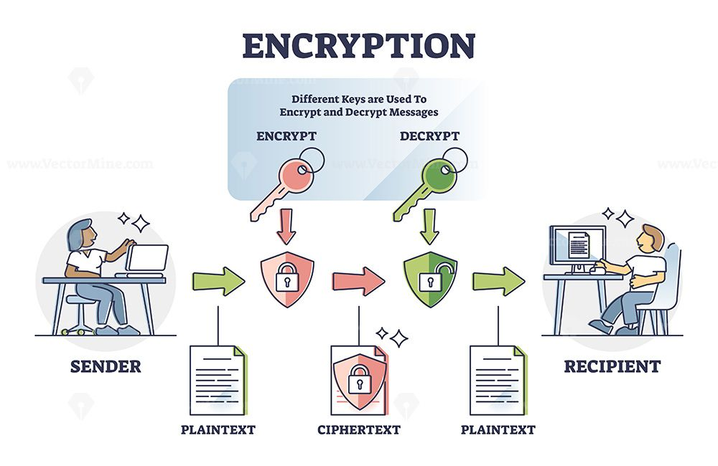
Classical Encryption Techniques
What is Encryption?
Encryption converts readable Plaintext into unreadable Ciphertext.
It protects information from unauthorized access during storage or transmission.
Caesar Cipher
Uses a fixed shift value to replace each letter.
Simple substitution cipher.
Example: HELLO → KHOOR (Shift = 3)
Vigenère Cipher
Uses a keyword to encrypt the message.
Each letter is shifted differently based on the keyword.
More secure than Caesar Cipher.
Hill Cipher
Uses matrix multiplication for encryption.
Encrypts groups of letters instead of individual characters.
Provides stronger security than simple substitution ciphers.

Slide 6

Applications & Key Takeaways
Applications
Secure Online Banking
Military Communication
Password Protection
VPN Security
Email Encryption
Digital Signatures
Cloud Security
IoT Device Security
Secure Mobile Applications
Key Takeaways
Information Security protects valuable digital information.
The CIA Triad ensures Confidentiality, Integrity, and Availability.
The Bell–LaPadula Model protects confidential information through access control.
Security attacks, threats, and risks must be identified and managed.
Classical encryption techniques are the foundation of modern cryptography.

Slide 7


THANK YOU

